Slide 1

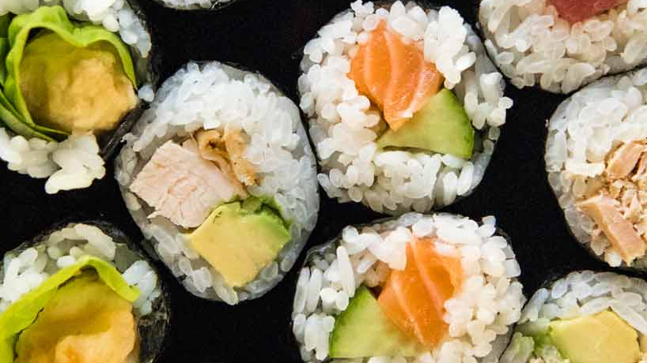


Battle of Neighborhoods – SUSHI RESTAURANT
Applied Capstone Project
- Jahnavi Sandhya

Slide 2
problem
Suggest top three neighborhoods to kick start a Sushi Restaurant with Japanese Cuisine
Target Customers
Residents
Universities
Offices
Shopping Malls
Try to avoid the concurrences of other food trucks from other competitors

Slide 3
Data acquisition and cleaning
Sources:
Foursquare data to find popular venues
https://data.cityoforlando.net/Government-General/Neighborhoods/dpx3-qjrc
How will the data be used to answer the business needs?
The data mentioned above will be used to explore and target locations across different venues present in the neighborhoods.
1. Use Foursquare and geopy data to map top venues for the super neighborhoods of Orlando and cluster them in groups
2. City-Data to get the neighborhoods information
3. Additional data will be added from open data sources if available in the future if the data is insufficient
Cleaned data consists of ** neighborhoods along with their latitude and longitude

Slide 4
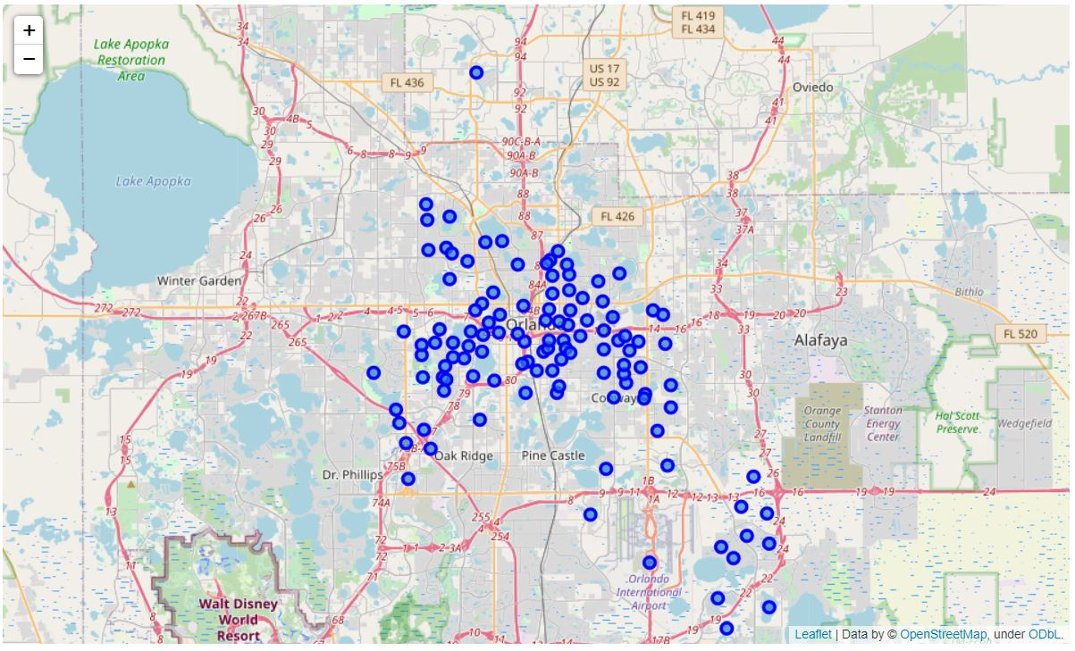

Slide 5
MEthodology
Map venue categories Sushi Restaurants, Residential Areas, Universities, Offices, and Shopping Malls
Assign each venue category weights and calculate a weighted score by creating a matrix
Sort it by descending having the highest score at the top

Slide 6
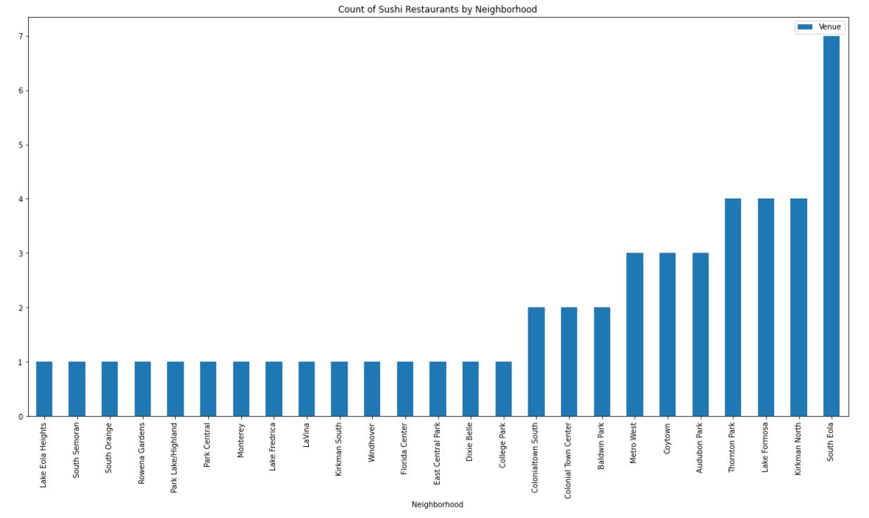
SUSHI RESTAURANT per each neighborhood
Visually representation that the count of sushi restaurants are high in the following neighborhoods,
South Eola
Krikman North
Lake Formosa

Slide 7
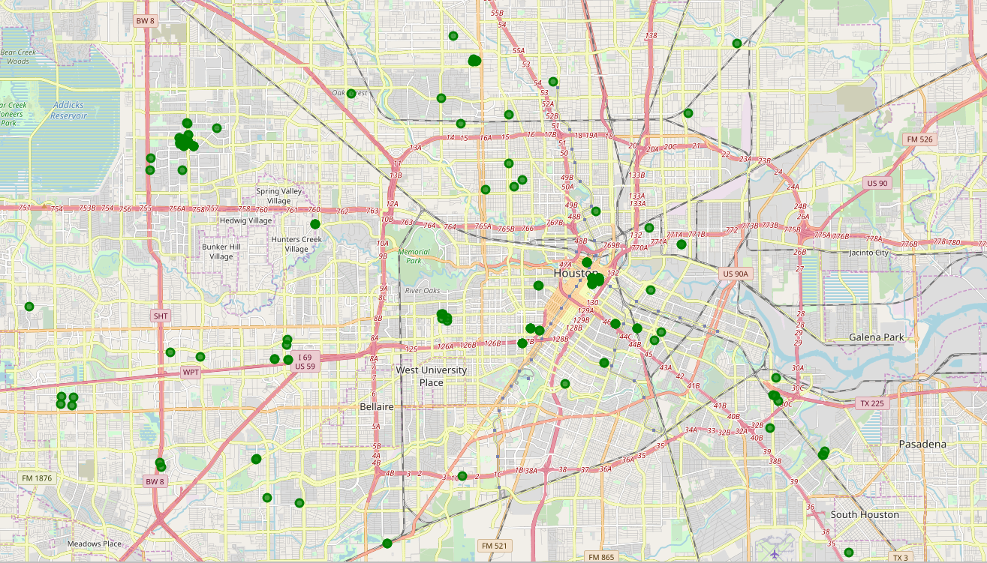
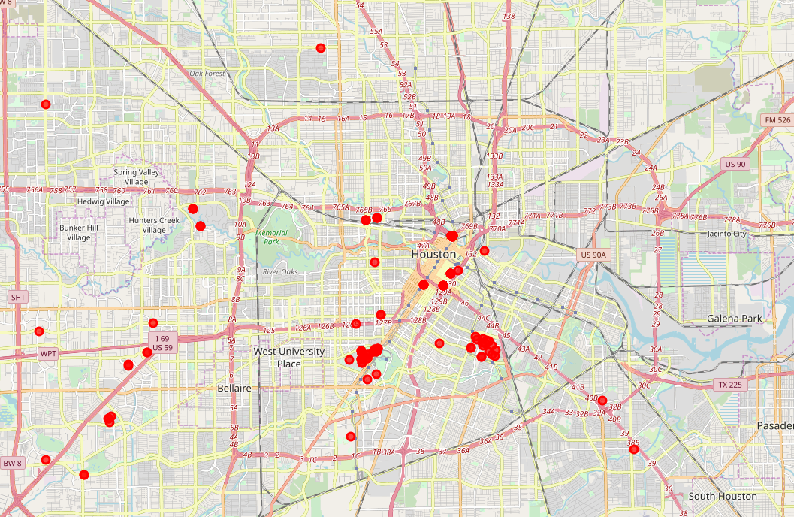
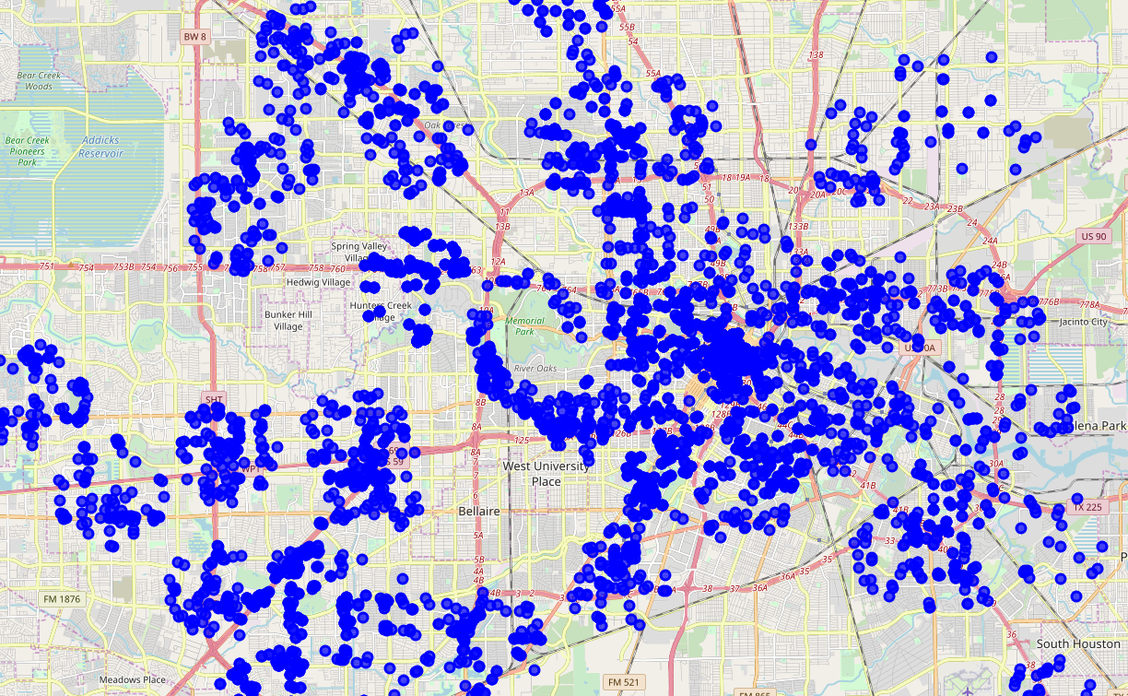
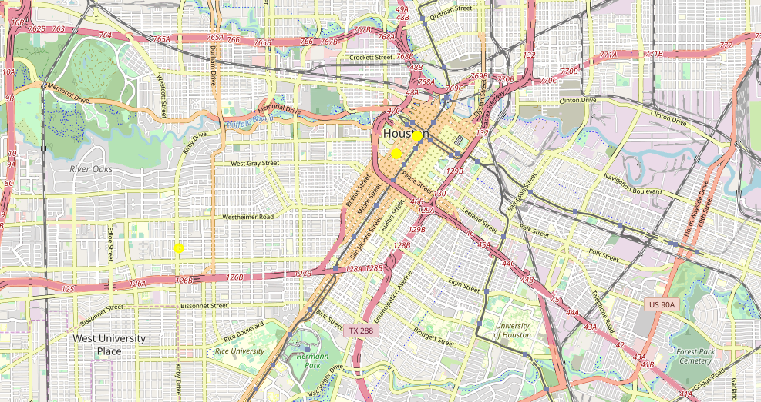
Plotting Venue categories
Map of Universities in the Houston Neighborhoods plotted in green
Map of Universities in the Houston Neighborhoods plotted in red
Map of Offices in the Houston Neighborhoods plotted in blue
Map of Shopping Malls in the Houston Neighborhoods plotted in yellow

Slide 8
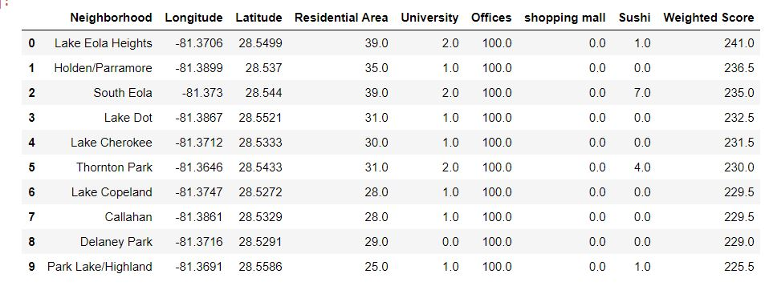
From previous slide we get a visualization of count of venues which are closer to the downtown are the high comparatively to the outskirts of the downtown which is an expected result.
Weights are assigned to each venue category, Sushi Restaurant being in negative since we need to avoid the concurrences of other restauants, positive values for the other categories since they are the target audience. Offices have high weights than the other categories since they would be the prime target for this business.
Performing calculation using the formula below,
x = (y * i) + (y1 * i1) + ........... + (n * m)
we calculate the weighted score for each neighborhood by creating a weighted matrix as shown below.

Slide 9
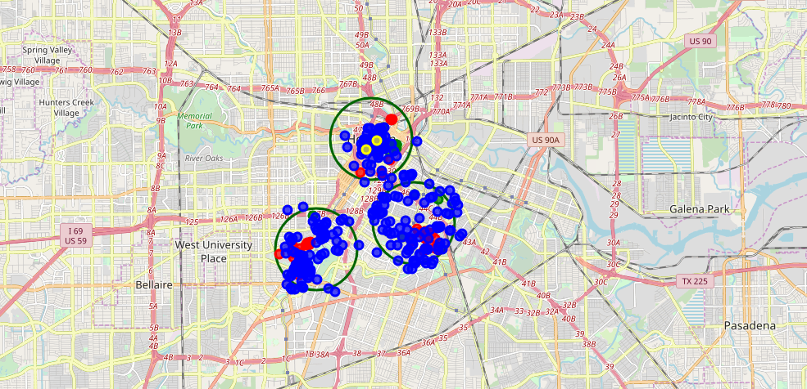
results
After the analysis and calculations we can observe the top three neighborhoods in Orlando to start are food truck are,
Memorial
Third Ward
Medical Center
Map of Top three neighborhoods in the Orlando encircled within the green circle

Slide 10
Conclusion
Based on the analysis the client should start their Sushi Restaurants in the following three neighborhoods,
Memorial
Third Ward
Medical Center
Upon further analysis, the client can also do business in the next three neighborhoods,
Wayside
Museum District
Pembertown
Limitations,
Geopy could not yield the results for all the super neighborhoods in Orlando which were excluded from the data and few of the other neighborhoods have the same co-ordinates which could mean that the neighborhoods are close to each other or the Geopy is producing faulty co-ordinates
Accuracy of venues purely depends on Foursquare

